Slide 1
EaP-CoE Facility Project Good Governance and Fight against Corruption Results and Achievements April 2012-April 2013

Slide 2
Expected results
Regional
ER1: Policy and prevention
ER2: Law enforcement and fighting economic crime
National
ER3: Pilots – specific country needs

Slide 3
ER1: Policy and prevention
Area of Intervention | Activity | Results | Participants
Anti-corruption policies | Regional Conference and Workshops with inputs from each country | Handbook on Designing and Implementing AC policies (English, Russian) | National experts Civil society
Risk Assessment Methodology | Regional Workshop on methodology (Strasbourg) | Tools on how to carry risk assessments | Gov. institutions
Risk Assessment on Ethics in civil service | Ethical weaknesses in service delivery (Azerbaijan) | Risk Assessment report; Recommendations | Gov. institutions NGOs
Risk Assessment on local government | Corruption risks in local governments (Moldova) | Risk Assessment report; Recommendations | Gov. institutions NGOs
Risk Assessment on Income and asset declarations | Financial supervision of public officials (Ukraine and Armenia) | Risk Assessment report; Recommendations | Gov. institutions NGOs
Risk Assessment | Regional Conference: Presentation of Risk Assessment (Chisinau) | 4 Risk Assessment reports presented and reviewed; Draft Regional Typology Study on underlying causes of corruption | Gov. institutions Int. organisations NGOs

Slide 4
ER2: Law enforcement and fighting economic crime
Area of Intervention | Activity | Results | Participants
Prosecution of Economic Crime | Regional Training (Syracuse) | Training manual | Prosecutors Investigators Judges
Money Laundering Typology | Regional Workshop (Strasbourg) | Adopted: Methodology, ToR, Questionnaire; Country visits to Armenia, Azerbaijan and Ukraine carried out | FIUs Prosecutors

Slide 5
ER3: Pilot – specific country needs
Area of Intervention | Activity | Results | Participants
E-government | Roundtable on Good practices of e-government (Azerbaijan) | Presentations on international good practices | All central state bodies
Anti-corruption policies | 2 Workshops in local communities: Drafting anti-corruption action plans (Moldova) | 2 anti-corruption action plans 1 model action plan | Local government NGOs
Ethics | 2 Training of Trainers on ethics in public service (Azerbaijan) | Case scenarios and training guidance available in Azerbaijani | Ethics comm. HR
Verification of asset declarations | Drafting Manual on verification of asset declarations and Roundtable on good practices (Armenia) | Manual on processing and verifying asset declarations | Ethics comm.
Liability of legal persons | Roundtable on liability of legal persons (Ukraine) | Int. standards and GRECO recommendations; Draft law on liability of legal persons discussed | Gov. institutions NGOs Academia

Slide 6
On-going and next activities
Regional
ER1:
Finalising Country Risk Assessment: underlying causes of corruption (Belarus and Georgia)
ER2:
Finalising Typologies on laundering the proceeds of corruption (country visits to Belarus, Georgia and Moldova; regional workshop)
Training on criminal and civil liability for legal persons
Training on political financing
National
ER3:
3 Pilot activities (Belarus and Georgia)

Slide 7
Observations
17 activities (30 actions)
Good cooperation with beneficiaries
Active civil society involvement
Broad variety of European and international experts (EUMS and non EUMS: Bulgaria, Czech Republic, Denmark, Georgia, Germany, Italy, Latvia, Moldova, Poland, Romania, Switzerland, Turkey and UK)
Efficient use of other countries/regional experience
Turkey (Ethics - Azerbaijan); Albania (Methodology on Risk Assessment)

Slide 8
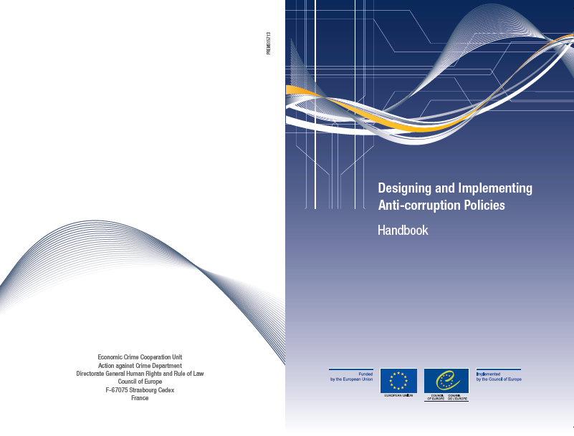
Publications

Slide 9
